Slide 1

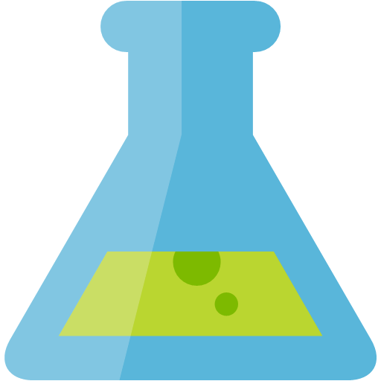


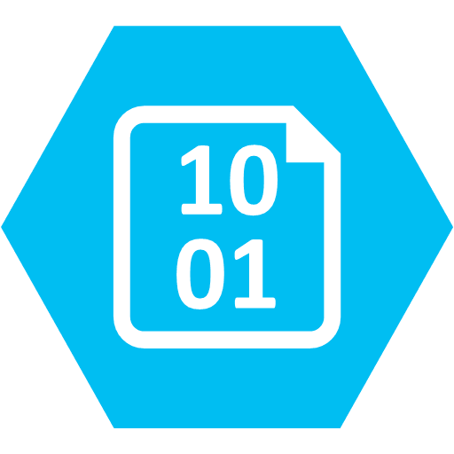
Lab Architecture
MODEL TRAINING
MODEL MANAGEMENT
AUTO ML
Track Runs & Register Models
Azure Machine Learning Workspace
Register Automated Machine Learning Model
Azure Machine Learning Compute
Azure Databricks (PyTorch & Keras)
INGEST
LONG TERM STORAGE
STREAM DATA PROCESSING
Retrieve Model
IoT Hub or Event Hubs
Azure Storage
Battery Telemetry
Azure Databricks (Spark Structured Streaming)
Simulated Data Stream
(NOTE: not used in the lab)
(NOTE: a CSV file of previously captured streaming data is provided to expedite setup)
BATCH DATA PROCESSING
Component Text
Azure Databricks (Spark DataFrames)

